Slide 1

Helping Your Child Thrive
Food, Sleep, Routine & Well-being

Slide 2



FOUNDATION FOR LEARNING
Why Well-being Matters for Young Children
Feeling Happy
Staying Healthy
Ready to Learn
Emotional balance supports confidence and positive relationships
Strong bodies and minds help children grow and fight illness
Proper rest and nutrition unlock concentration and memory
Food, sleep, and routines all work together to support your child's growth and mood. Small changes at home can make a big difference every day.

Slide 3

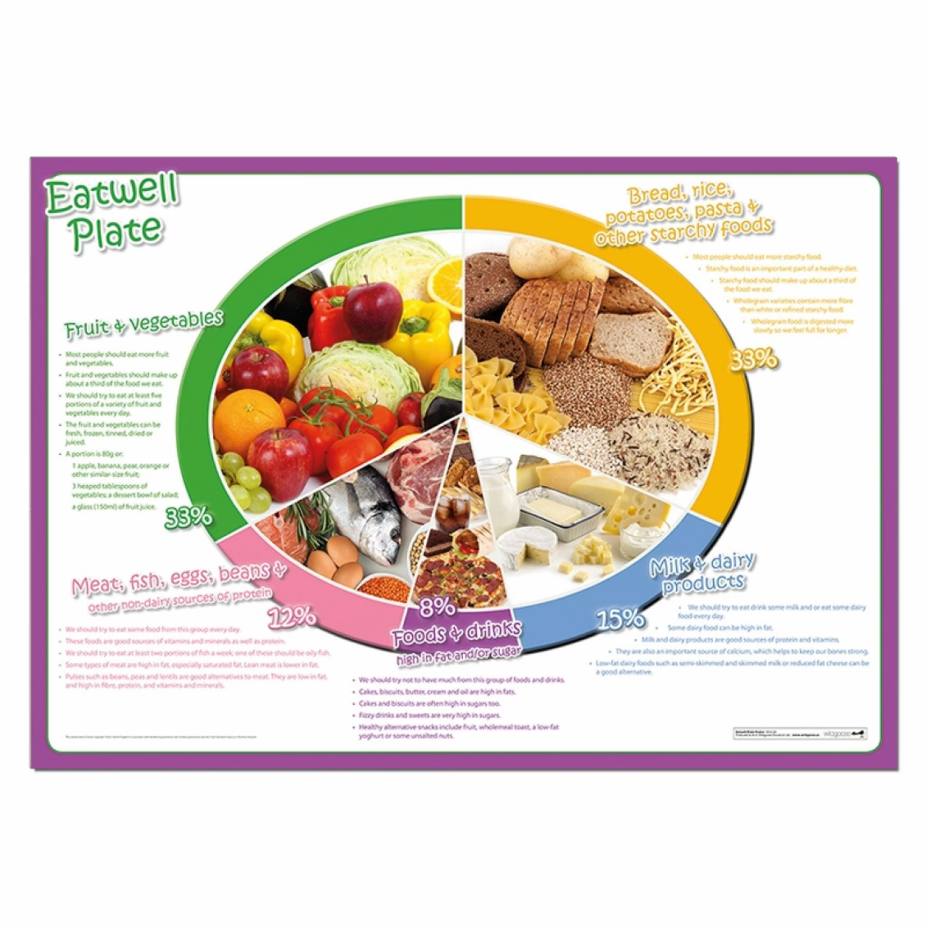
NUTRITION GUIDE
The Eatwell Guide: A Balanced Plate for Growing Kids
01
Fruit & Vegetables
At least 5 portions daily for vitamins and minerals
02
Starchy Foods
Potatoes, bread, rice, pasta for lasting energy
03
Protein
Beans, pulses, fish, eggs, meat for strong muscles
04
Dairy
Milk, cheese, yoghurt for healthy bones
05
Limit Sugar
Keep energy steady and protect teeth

Slide 4





How Food Affects Sleep and Behaviour
Nutritious Foods
Help produce melatonin, the natural sleep hormone
Better Sleep Quality
Heavy or sugary meals before bed disrupt natural sleep cycles
Improved Behaviour
Good sleep reduces irritability and supports concentration
Hydration matters: Water supports body temperature regulation and sleep quality throughout the night

Slide 5


SLEEP SCIENCE
Why Sleep Is Essential for KS1 Children
9-12
Hours Needed
Nightly sleep for ages 5-7
Physical Growth
Brain Development
Bodies grow and repair during deep sleep
Memory consolidation and learning happen overnight
Immune Health
Strong sleep strengthens the body's defences
Lack of sleep increases hunger for sugary, fatty foods, creating a cycle that affects overall health and well-being

Slide 6

Building a Healthy Sleep Routine
1
Consistent Times
Same bedtime and wake-up, even weekends
2
Calming Activities
Reading, quiet play, or gentle music
3
Screen-Free Hour
Avoid screens before bed for natural sleep signals
4
Positive Praise
Encourage good habits with recognition

Slide 7



The Magic of Bedtime Reading
Turning pages together isn't just about stories; it's a powerful ritual that nurtures your child's mind and prepares them for restful sleep.
Calms the Mind
Strengthens Bonds
Quiet stories help little minds switch off from the day's excitement, promoting relaxation and preparing for dreams.
Sharing a book creates a precious, intimate moment, reinforcing your connection and building emotional security.
Boosts Literacy
Regular reading expands vocabulary, sparks imagination, and instills a lifelong love of books.

Slide 8
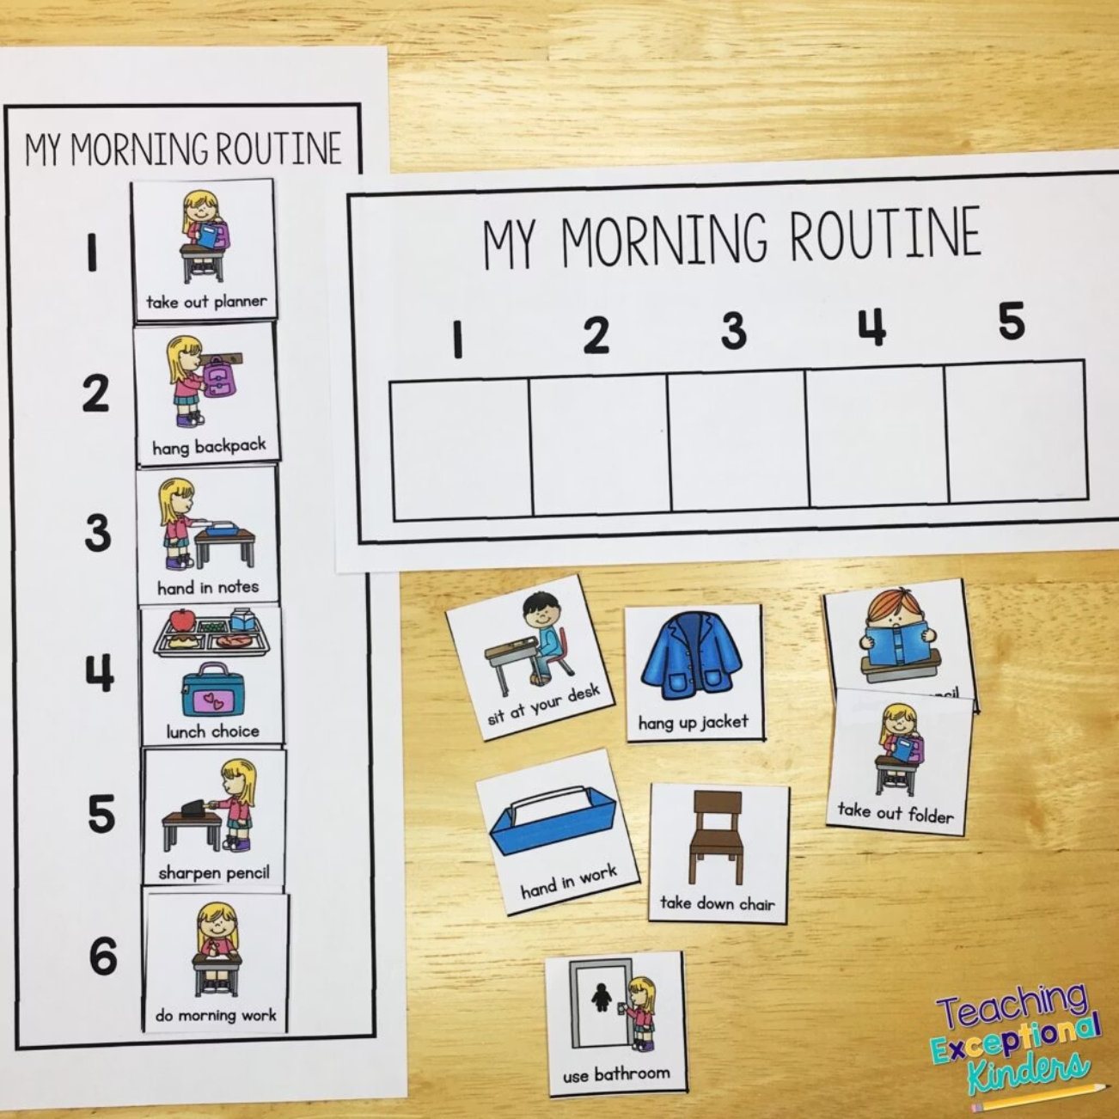
STRUCTURE & SECURITY
The Power of Daily Routines for Well-being
Security & Comfort
Routines reduce anxiety by creating predictability
Structured Day
Regular meal times, play, learning, and rest build balance
Independence
Involving children in planning encourages cooperation
Children who know what to expect feel more confident, settled, and ready to engage positively with the world around them.

Slide 9
Tips for Parents: Linking Food, Sleep & Routine
1
2
Plan Evening Meals Early
Choose Balanced Snacks
Eat 2-3 hours before bedtime to aid digestion and promote better sleep
Offer fruit or yoghurt instead of sugary treats for sustained energy
3
4
Keep Water Accessible
Use Visual Tools
Encourage hydration throughout the day and into the evening
Charts or timetables help children follow routines independently

Slide 10




SUCCESS STORIES
Small Changes, Big Impact
Happier Children
Better School Settling
Lasting Well-being
Regular bedtimes and balanced meals create more energetic, positive kids
Good routines help children adjust to school and reduce tantrums
Consistency builds healthy habits over time for long-term benefits
"Consistency is key: routines and healthy habits build over time"

Slide 11

Your Role as a Parent: Supporting Healthy Growth
Be a Role Model
Progress Over Perfection
Strong Foundation
You're your child's greatest influence for healthy habits
Food, sleep, and routines work together for your child's future
Every positive step counts — celebrate small wins
Let's work as a team to help our children flourish every day!

